Slide 1

SEND Information Report
Published on: September 2026
(This report outlines SEND provision and outcomes for the academic year 2026/2027)
To be reviewed: September 2027

Slide 2
Contents
1. | The different kinds of needs we are proud to support at our school​ | 2. | Who you can talk to about support for children with additional needs​
3. | The skills and training of our staff, and how we bring in extra expert help when needed​ | 4. | How we notice and understand when a child may need extra support​
5. | How we help children to learn, grow and thrive with the right support 5a . How we check that support is making a difference​ 5b. How we celebrate and track children’s progress​ 5c. Our positive approach to teaching and learning​ 5d. How we adapt lessons and classrooms to help every child succeed​ 5e. Extra help that can be offered when it’s needed​ 5f. How all children are included in every part of school life​ 5g Support for children’s wellbeing, confidence and friendships​ | 6. | How we make sure the right equipment and facilities are available for children​
7. | How we work together with parents and carers to support every child’s journey​ | 8. | How we listen to children and young people and involve them in decisions about their learning​
9. | How parents and carers can share concerns and know they will be listened to​ | 10. | How we work closely with other services and organisations to support children and families​
11. | Where parents and carers can find extra advice, help and support​ | 12 | How we support children as they move on to new schools or prepare for adult life​
13. | Where to find the Local Authority’s Local Offer (a guide to all the services and support available in the area)

Slide 3
1. The different kinds of needs we are proud to support at our school
There are four main types of special educational needs: how a child learns, how they communicate and interact with others, their social and emotional wellbeing, and any physical or sensory needs. When we assess a child, we look at which of these is their main area of need. Here are some examples of conditions that children might have under each of the four main areas of special educational needs. Every child is different, and these are just examples to help explain what we mean.
Cognition and Learning: Dyslexia Dyscalculia | Communication and Interaction: Autism spectrum disorder (ASD) Speech, language, and communication needs (SLCN)
Social Emotional and Mental Health Needs: Attention deficit hyperactivity disorder (ADHD) Anxiety | Physical and/or Sensory: Hearing impairment Sensory processing disorder

Slide 4
1. The different kinds of needs we are proud to support at our school
This chart shows the main areas where we gave children support in our school during the academic year of 2026/2027.
This chart illustrates the primary type of support each child requires. Some children may need extra help in more than one area, but only their main need is shown here.

Slide 5
2. Who you can talk to about support for children with additional needs
Name | Role | Contact details
Miss Nye | Assistant Head Teacher (SENDCo, Inclusion and Pastoral Lead) | senco@ursulataylor.bedssch.co.uk
Mr Matthews | Deputy Head Teacher | senco@ursulataylor.bedssch.co.uk
Mrs Guest | SEND Admin and interventions lead | senco@ursulataylor.bedssch.co.uk
Mrs Lane | KS1 Lead | office@ursulataylor.bedssch.co.uk
Mrs Llewellyn | KS2 Lead | office@ursulataylor.bedssch.co.uk
Mrs Louise Tyrrell | SEND Governor | office@ursulataylor.bedssch.co.uk

Slide 6
3. The skills and training of our staff, and how we bring in extra expert help when needed
Staff | Qualification/Training | Outcome
Mr Matthews (SENDCo) | NPQSENCO (Ongoing) | Designed to build expertise in leading inclusive practices, mastering the SEND framework and legislation, and improving outcomes for pupils with special educational needs.
Miss Nye (AHT/SENDCo) | National Award for Special Educational Needs Coordinators | Designed to build expertise in leading inclusive practices, mastering the SEND framework and legislation, and improving outcomes for pupils with special educational needs.
Whole school | Provision Mapping Implementation | Staff using centralised system to monitor provision across the school.
Mr Matthews (DHT), Miss Witzcak | Team Teach | Learning de-escalation techniques to reduce risk, improving teamwork and communication, developing confidence, and ensuring a safer environment for both staff and the people they support.
Mr Matthews (DHT), Miss Nye (AHT/SENDCo) | SEND Law Training | To make you aware of the types of SEND appeals and an outline of the process Responding to a consultation request and applying the legal test Expectations of an expert witness in a SEND appeal including your legal duties Preparing a witness statement for the SEND appeal Attendance at the SEND appeal hearing
Whole School | Zones of Regulation Training | Whole School approach to managing wellbeing, mental health, social and emotions and behaviour.

Slide 7
4. How we notice and understand when a child may need extra support
1. Observation by Teachers and Staff
Teachers are often the first to notice signs that a child may need additional help. They look for:
Academic struggles: Difficulty with reading, writing, math, or following instructions.
Behavioral signs: Withdrawal, aggression, hyperactivity, or difficulty staying focused.
Social challenges: Trouble making friends, poor communication, or conflict with peers.
Emotional indicators: Anxiety, sadness, low self-esteem, or frequent frustration.
2. Monitoring Progress
Schools use tools like:
Baseline assessments and ongoing evaluations to track academic progress.
Standardized tests to compare performance with age-related expectations.
Learning journals or teacher notes to document patterns over time.
3. Communication with Parents/Guardians
Teachers may reach out to parents to:
Share concerns and observations.
Ask about behavior at home.
Collaborate on strategies to support the child.

Slide 8
4. How we notice and understand when a child may need extra support
We want every child to get the support they need to learn and thrive. You can find out more about how we do this in our school policies, including how we keep children safe, support those with additional needs or medical conditions, make sure everyone is included, and listen to parents’ views. You can view all our policies:
Policy Name | Link
SEND policy | https://www.ursulataylorschool.co.uk/storage/secure_download/MU9SczBQT1RvdWNudmFOeDhNMFhaQT09
Accessibility plan | https://www.ursulataylorschool.co.uk/storage/secure_download/RjZXL1B1OGZqcU5mcSt4RVJOUVRtQT09
Safeguarding Policy | https://www.ursulataylorschool.co.uk/storage/secure_download/ck53T3BKMksrNnJDUm02SHlhQTdSZz09
Behaviour Policy | https://www.ursulataylorschool.co.uk/storage/secure_download/R0F6T1dTMkg1SFpqV2tPNG1mUHEzQT09
Supporting pupils with medical conditions | https://www.ursulataylorschool.co.uk/storage/secure_download/M3dkMWx1aWpHNElZNzIwVEIxc0pGdz09
Admissions Arrangements | https://www.ursulataylorschool.co.uk/storage/secure_download/MUorazdrM0ZmK0krcHNLbGMrMnhqZz09
Complaints Policy | https://www.ursulataylorschool.co.uk/storage/secure_download/YTlJQlExa1pSQlRrclpjN3FCUC9wUT09
Equality information and objectives | https://www.ursulataylorschool.co.uk/storage/secure_download/RDlGZ2d6OXFkdkc1bk54YnhBMUZMUT09

Slide 9
5a . How we check that support is making a difference​
How often children are assessed
At our school, children are assessed through an ongoing assessment of Ladders, which is a small steps of progress document. Individual Support Plans (ISP) are reviewed and SMART targets are rewritten termly.
How this links to reports and review meetings
The school liaises with external professionals and the local authority, in addition to the pupil's parents through review meetings. These meetings are designed to celebrate successes, track progress, and agree on next steps together.
How interventions help
Some children benefit from extra support, such as targeted reading, maths boosters, speech and language sessions, Zones of Regulation interventions and many more in-depth learning opportunities. These are recorded in ISP Intervention books that clearly demonstrate the intervention that the pupil is receiving and the impact it is having on their development and progress. These ISP Intervention Books are closely monitored by the SENDCo.

Slide 10
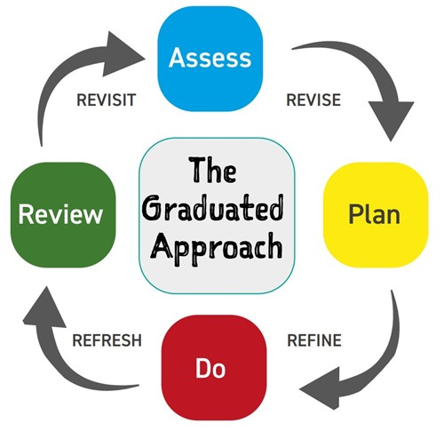
5b. How we celebrate and track children’s progress
Assess, Plan, Do, Review cycle at Ursula Taylor:
1. Assess This is where the school works out what your child needs help with. The teacher will: Look at how your child is doing in class Notice if they're finding some things harder than expected Talk to you and your child about what they've noticed | 2. Plan Once the school understands your child's needs, they'll work with you to decide how to help. Together, you'll agree on: What support your child will get (this might be extra help in class, special resources, or working in a small group) What you're hoping to achieve When you'll meet again to see how things are going
3. Do This is when the plan is put into action. Your child's teacher: Remains responsible for your child's learning every day Works with teaching assistants or specialists to provide the agreed support Makes sure the support links to what's being taught in class | 4. Review The school looks at whether the support is working by: Checking your child's progress Talking to you and your child about how things are going Deciding if any changes are needed

Slide 11
5b. How we celebrate and track children’s progress
Sometimes, children need extra help to understand how they learn best or to support their health and wellbeing. When this happens, we may ask specialists (experts in particular areas) to assess your child. This simply means they'll spend time getting to know your child better and understanding what support would help them most.
Common Types of Assessments:
Profession | What they access
Educational Psychologist (Through Bedford Borough Council) | How your child learns, thinks, and processes information.
Speech and Language Therapist (NHS) | How your child understands and uses language, speech sounds, and communication skills.
Occupational Therapist (NHS) | Fine motor skills (like handwriting), coordination, sensory processing, and daily living skills

Slide 12
5b. How we celebrate and track children’s progress
When an EHC Needs Assessment Might Be Appropriate:
An EHC (Education, Health and Care) needs assessment is only appropriate if a child has long-term and complex special educational needs and the school or early years setting cannot meet all those needs from its existing resources. The local authority will check if the child’s progress, the support already in place, and the legal “SEND Code of Practice” guidance indicate that a full assessment is needed. If a EHCP is appropriate, the whole process will take 20 weeks, from submitted the EHCP needs assessment request and receiving the final amendment.
How and When Parents/Carers Are Involved:
Parents and carers are included from the start, when concerns are first raised, during the assessment process, and in planning any extra support. Their views and knowledge of their child are very important. When the assessment request is made, the local authority gathers views from parents/carers and the child/young person themselves, as well as information from school and other professionals. If an assessment is not agreed, parents/carers will be given written feedback and invited to a meeting to discuss next steps.
Further information can be found here: Bedford Borough EHCP

Slide 13
5c. Our positive approach to teaching and learning
Quality First Teaching
Quality First Teaching is high-quality, inclusive classroom teaching that anticipates diverse learning needs and ensures all pupils can access ambitious learning through clear instruction, purposeful assessment, and proportionate adaptations.
Pupil grouping
During learning, children have the opportunity to work in small groups, talking partners and whole classroom discussions.
Supporting engagement
Some strategies that are used throughout the classroom to support engagement include; movement breaks, sensory breaks, targeted interventions, manipulatives, visual prompts and resources, now and next boards, visual timetables etc.
Supporting transitions
Some strategies that are used throughout the classroom to support visual reminders, now and next boards, countdowns and timers, TA supported transitions, visual timetables etc.

Slide 14
5d. How we adapt lessons and classrooms to help every child succeed
Making written information accessible
Written information is made accessible at Ursula Taylor schools by providing appropriate support for pupil's including coloured overlays and coloured text books for pupils with a diagnosis of Dyslexia, and providing larger prints. Access arrangements are made for pupils who need additional support to access written information during SATS.
Adapting the curriculum
The classroom and sensory environment, the curriculum, learning spaces, pupil's individual timetables, assessments are all appropriately adapted to meet the needs of all children. Some pupils may have a bespoke curriculum if they are working significantly below age-related expectations.

Slide 15
5e. Extra help that can be offered when it’s needed​
At Ursula Taylor, our dedicated teaching and learning staff deliver high-quality interventions to support children with cognition and learning needs, communication and interaction needs, social, emotional and mental health needs, physical and sensory needs, and pupils who need further language support if English is their additional language. The below table illustrates the interventions that are happening throughout the school:
Cognition and learning | Communication and interaction | Social, emotional and mental health | Physical and/or sensory
Maths Boosters Precision teaching The Yark Mastering Numbers Spelling Shed TTRockStars Comprehension Common Exception Words Maths Fluency Handwriting Phonics | Speech and Language sessions Thrive Play Therapy Support Visual supports (e.g., PECS, visual timetables) Social stories and comic strip conversations Structured social skills groups Language enrichment activities AAC tools (e.g., communication boards or apps) Simplified language and clear instructions | Zones of Regulation “BrainBreaks” Mentoring or key adult support Therapeutic interventions Mindfulness and relaxation techniques Positive behaviour support plans Safe spaces or sensory rooms | Sensory Circuits Fine Motor Intervention Physiotherapy Programme “Sensory Breaks” Occupational Therapy (OT) and Physiotherapy Adapted equipment (e.g., writing slopes, hearing aids) Environmental adjustments (e.g., quiet zones, lighting) Support with mobility and personal care Individual healthcare plans Fine/gross motor skill development activities

Slide 16
5f. How all children are included in every part of school life​
Below are examples of adjustments we can make across the four main areas of need. Every child is different, so support is personalised.
For further information, please see our accessibility plan (school website), which sets out how our school makes sure all children, including those with additional needs or disabilities, can take part in every aspect of school life.
Cognition and Learning: Bespoke personalised curriculum Scaffolding and modelling Word banks Pre-teaching of vocabulary Precision teaching Visual aids (WIDGIT) Resources and manipulatives | Communication and Interaction: Communication boards Visual communication cards (WIDGIT) British Sign Language Adaptive texts
Social, emotional and mental health: Regular SEMH check ins Zones of Regulation intervention External professional session (CAMHS etc) Social interaction interventions | Physical and/or sensory: Access to the sensory room Fidget toys Ear defenders Pencil grips and fine motor support

Slide 17
5g. Support for children’s wellbeing, confidence and friendships​
Culture and ethos of the school
The ethos and values of our school are extremely important to everyone at UTS. Our strap line of 'Living Gods' Love, Together We Flourish' is central to what we believe and evident in the way we support and work with all our children and families. All staff take great pride in being kind and compassionate and dedicated to serving the needs of our community. We use the Biblical Scripture of ' I am the Vine; You are the Branches. If you believe in me and I in you, you will bear much fruit' John 15:5 to enhance our ethos and link our learning, successes and experiences to our collective flourishing. We have been a 'Values' school for many years, this encompasses our distinctively Christian Values and important British and Human values which we teach and live our lives by. As a Church of England School, we place our Christian distinctiveness and ethos at the heart of our work. Our close and extremely supportive relationship with Rev. Stephen Liley and Min-Min Peaker from Clapham Church is a strength which we draw from during the life of the school and through Stephen and Min-Min's weekly worship. We also have a very positive and supportive relationship with the Diocese of St Albans, our partner Trust schools in the Diocese of St Albans Multi-Academy Trust and our local schools whom we work together with wherever possible.
Organisation of pastoral care
At Ursula Taylor CE School, we want children to feel happy and safe at school and we do this by supporting emotional, mental and social well-being. This include pastoral monitoring, regular well-being check ins, and a consistent and fair behaviour policy. Some pupil may have access to, where appropriate, counselling sessions from external professional such as CAMHS. Ursula Taylor also delivers a Nurture group which is a small, short‑term school intervention (usually 6–12 pupils) designed to support children with social, emotional, or behavioural difficulties so they can better access learning. It provides a safe, structured environment run by two trained staff members and is based on the Six Principles of Nurture.

Slide 18
6. How we make sure the right equipment and facilities are available for children
How SEND funding in the current academic year is being spent
Commissioned specialist services
SEND funding is used to commission external professionals who provide targeted support for pupils with additional needs. This includes services such as:
Educational psychologists for cognitive and behavioural assessments
Speech and language therapists to support communication development
Occupational therapists to assist with motor skills and sensory integration
Specialist training for staff
Funding is allocated to ensure staff receive high-quality training to meet the diverse needs of pupils. Examples include:
Autism awareness training to help staff understand and support autistic learners
Dyslexia strategies workshops for effective literacy interventions
Mental health support training to promote emotional well-being and resilience
Specialist assessments for individual pupils
SEND funding is used to carry out detailed assessments for pupils who require additional support. These may include:
Learning assessments to identify specific learning difficulties
Speech and language evaluations to develop tailored communication

Slide 19
7. How we work together with parents and carers to support every child’s journey
Supporting parents/carers to share their views and participate
We actively involve parents and carers in their child’s SEND journey through:
• LSP Review meetings to discuss progress and next steps
• SEND-specific meetings for targeted support planning
• Questionnaires and surveys to gather feedback.
Day-to-day communication with the SENDCo/teachers
Parents and carers can contact the SENDCo or class teachers through several convenient channels:
• Class Dojo for updates and questions
• Email for ongoing updates and questions
• Phone calls for discussions
• Home-school contact book for daily notes and feedback
• Scheduled meetings arranged at mutually convenient times.
Using parents/carers’ views to improve provision
Feedback from parents and carers is essential for shaping our SEND provision.
Collect input during review meetings and surveys
Use feedback to refine intervention strategies and resources
Incorporate suggestions into future SEND plans
Share outcomes with parents to maintain transparency and trust

Slide 20
8. How we listen to children and young people and involve them in decisions about their learning
Supporting pupils to participate and share their views in school Pupils with SEND are actively encouraged to take part in school life and express their opinions through:
Questionnaires and surveys designed to gather feedback on their learning experience
House Captain representation, ensuring their voices contribute to whole-school decisions
Class discussions and circle time, where pupils can share ideas in a supportive environment
Visual aids and communication tools (e.g., symbols, apps) to help pupils who find verbal communication challenging.
Opportunities outside school. We make pupils with SEND aware of and support them to access activities beyond the classroom by:
Providing information about SEND-specific clubs and community activities
Liaising with external organisations that run inclusive programs, such as sports or arts activities
Offering parent workshops and guidance to help families find suitable opportunities
Supporting pupils with transport arrangements or additional adult support where needed
Involvement in decisions about their support. Pupils are given meaningful opportunities to share their views and be involved in planning their support through:
• SEN Support review meetings, where their opinions are recorded and considered
• Annual reviews of Education, Health and Care (EHC) Plans, ensuring their aspirations are central to planning
• One-to-one discussions with key staff to explore what works well and what could improve
• Using online tools or apps that allow pupils to express preferences in a way that suits them (e.g., visual choice boards, digital surveys).

Slide 21
9. How parents and carers can share concerns and know they will be listened to
If parents/carers are not happy with provision or have concerns about the support their child is receiving, they should follow the following steps
Speak directly to the class teacher to discuss any immediate issues
Contact the SENDCo (Special Educational Needs Coordinator) for more detailed discussions about provision and strategies
Arrange a meeting with the senior leadership team if concerns remain unresolved
Use home-school communication channels (email, phone, or planner) for ongoing dialogue.
If concerns cannot be resolved informally, parents/carers can make a formal complaint by submitting the complaint in writing, either by letter or email, using the DSMAT’ complaints policy, available on the school website.
Parents/carers who wish to make a formal complaint can access:
• SENDIASS (Special Educational Needs and Disabilities Information, Advice and Support Service) for impartial advice
• Parent support services offered by the local authority
• School guidance documents, including the complaints policy and SEND Information Report
• Pastoral support team, who can help explain processes and next steps.
SENDIASS - Support | Bedford Local Offer
DSMAT Complaints Policy

Slide 22
10. How we work closely with other services and organisations to support children and families
In our school, we sometimes work with other services to make sure children with special educational needs get the right help.
Education | Health | Social Care
Educational Psychology Team | Speech and Language Team | Early Help Team
Early Years Support Team | Occupational Health Team | Social Care
Autism Spectrum Advisory Teachers | Community Paediatricians | Children with Disabilities Team
Sensory and communication support team | School Nursing Team
Specialist Teacher Team | Mental Health Support Team

Slide 23
11. Where parents and carers can find extra advice, help and support
SENDIASS (Special Educational Needs and Disabilities Information, Advice and Support Service) is a free and confidential service that offers advice and support to children and young people with SEND, and to their parents and carers.
Open Monday to Thursday 9 am to 5 pm and Friday 9 am to 4:30 pm (TERM TIME ONLY.)
Telephone number: 01234 276267.
Email address: Sendiass@bedford.gov.uk
Website: Bedford SENDIASS

Slide 24
12. How we support children as they move on to new schools or prepare for adult life
Information sharing
Share SEND documentation, support plans, and progress reports securely.
Communicate with receiving schools to ensure continuity of support.
Planning support for transitions
Work closely with families to understand individual needs
Coordinate with the new setting to share relevant information
Arrange transition meetings involving parents, pupils, and key staff.
Person-centred reviews
Strengths, interests, and aspirations
Preferred learning styles and support strategies
Voice and choices, ensuring they are central to planning.
Staff understanding
One-page profiles summarising key needs and strategies
Briefings before the pupil starts
Ongoing updates from the SENDCo and pastoral team
Learning about new pupils
Review previous records and reports
Hold meetings with families and previous settings
Offer school visits for pupils to become familiar with the environment.
Supporting new pupils
Providing welcome sessions and buddy systems
Offering visual guides and social stories for pupils who need extra reassurance
Ensuring staff availability for questions and emotional support
Building relationships with parents/carers
Hold introductory meetings to establish trust
Maintain open communication channels (Class Dojo, email, phone, meetings)
Provide clear guidance on school routines and expectations
Future planning support
Encouraging goal-setting for education, work, and independence
Linking with external agencies
Supporting life skills development.

Slide 25
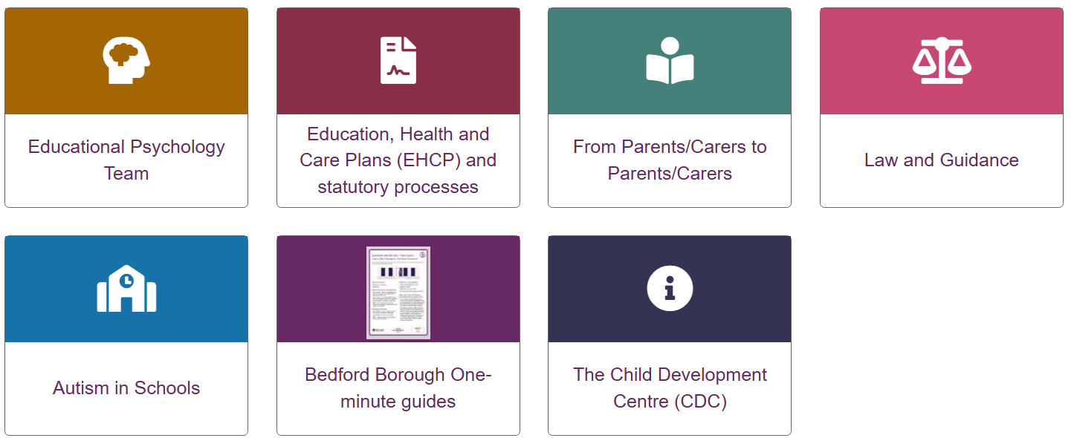
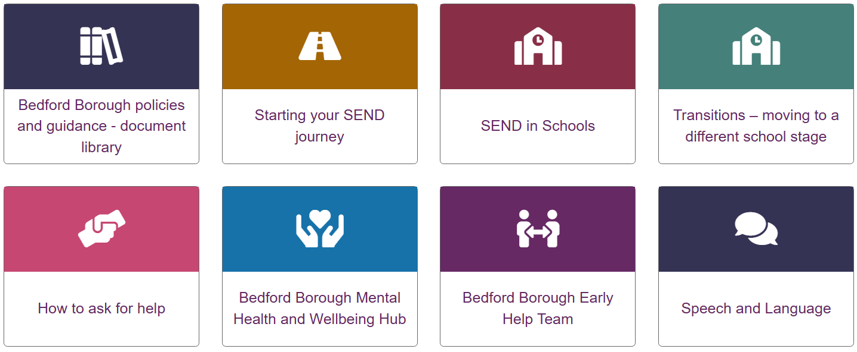
13. Where to find the Local Authority’s Local Offer (a guide to all the services and support available in the area)
The Local Offer is an online guide to all the services and support available in your area for children and young people with special educational needs or disabilities, and for their families. It includes information about education, health, social care, activities, and support groups.
Bedford Borough Local Offer

