Slide 1
Parent Phonic Workshop
Foundation Stage
11.10.2022

Slide 2
Outcomes of this session…
Introduction to phonics
Key terminology
Early reading skills
Expectations
Resources
Examples

Slide 5
Key Terminology

Slide 6
Key Terminology
Blend- saying the individual sounds that make up a word and then merging the sounds together to say the word.
Segment- This is the opposite of blending. You split the word up into the different sounds.
CVC Words- abbreviation used for consonant-vowel-consonant words, used to describe the order of sounds. Other abbreviations include VC Words or CCVC words.
Digraph- two letters which together make one sound.
Trigraph- three letters which together make one sound.
Grapheme- written letters or a group of letters that represent one single sound (phoneme) e.g a, sh, air, ck.
Sight words/ tricky words- words that you can not sound out and blend, you must learn these by sight.

Slide 8
Early Reading Skills – Phase 2 and 3
We learn the individual letter sounds.
We use sound buttons and sound lines to begin blending and segmenting VC and CVC words.
We learn our sight words.
We begin to read sentences.
We can talk about what we are reading, comprehension is a big part of the new Foundation Stage curriculum (reading is split into word reading and comprehension).

Slide 9
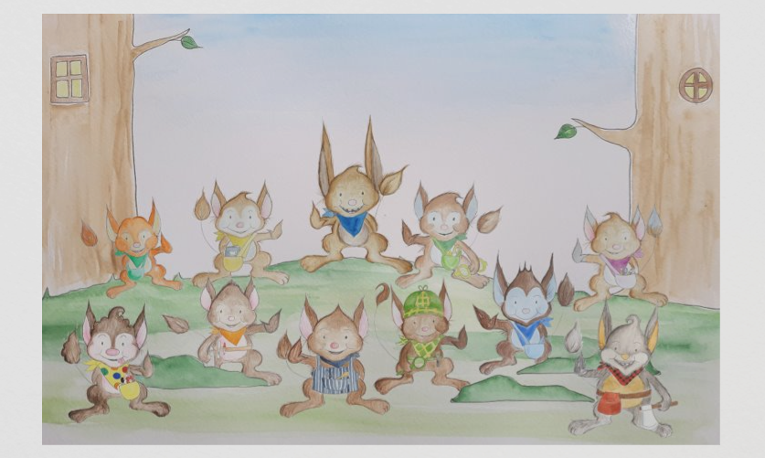
The Characters
Reading Rex
Listening Len
Building Bill
Nonsense Nan
Tricky Word Tess
Segmenting Seb

Slide 10
Expectations
We will teach daily class phonics and support children with activities to apply our new skills.
We will read with your child at least once a week at school- please bring your reading pack every day as we will often read extra when we can.
We will be sending home a reading pack so you can read with your child, play games and practise sounds 4 times a week - this needs to be little and often.
Bedtime stories, as often as possible, are very important. Children need to hear the language and watch you model reading a story, also promoting a love for reading.

Slide 11
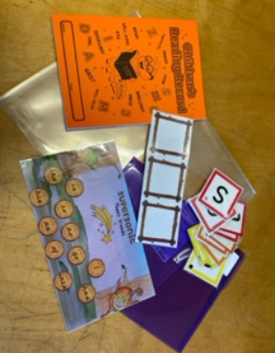
Reading Pack
Phoneme frame
Reading books (2 per week)
Library book
Sound cards – phonemes, digraphs and trigraphs
Sight word/tricky word mat (after your child has retained the first 3 sets, 12 sounds)- we will indicate the focus words of the week using green dots and pink dots when achieved.
Reading diary- we will comment in green for the next steps/learning focus and pink for positive praise.

Slide 12
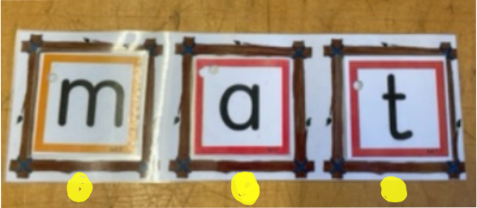
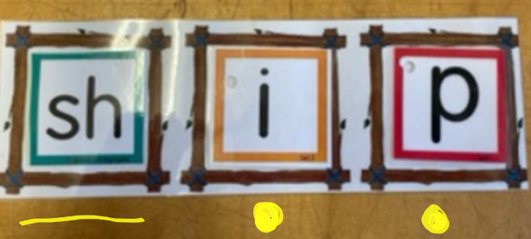
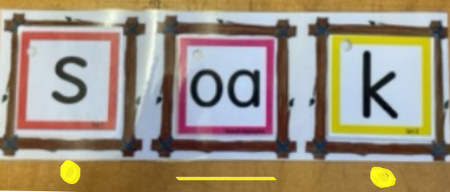
Using the phoneme frame

Slide 13
Examples- Phonic Activities
Speedy sounds
Building words on your phoneme frame
Reading words on your phoneme frame
Secret code
Hiding sounds in your house
Splat the sound
Play I spy and other initial sound games
Sound robots
Sound snap
Matching sounds
Fishing for sounds
Sound drums

Slide 14
Examples- Book Activities
Find sight words in the book
Pointing finger- follow the sound
Reading with funny voices and tones
Take turns reading pages
Reading to different family members
Make a reading video
Switch roles- children encourage the adult to read and assist with sounds
Find a specific word in the book – hunt the word

Slide 15
Examples- Comprehension Activities
Ask children to predict what they think the story will be about after looking at the front page
Discuss the characters in the story
Ask about how the characters may feel in certain parts of the story
Re read books for understanding
Ask about the main events in the book
Order main events in the story
Talk about your favourite part of the story, explain why
Ask children to predict what happens next in the story
Compare the book to another familiar story

Slide 16
Parent Resources Please check the class Dojo

